Slide 1

Mass Extinguisher
Robby Piwko, Bailey Russo, Aiden Thinn

Slide 2

Mass Extinguisher
2D platformer
Run through burning buildings to save the people inside
Backtrack through the level to escape after finding the person
GOAL: Rescuing the person and bringing them back to safety
Die by touching the fire for an amount of time

Slide 3
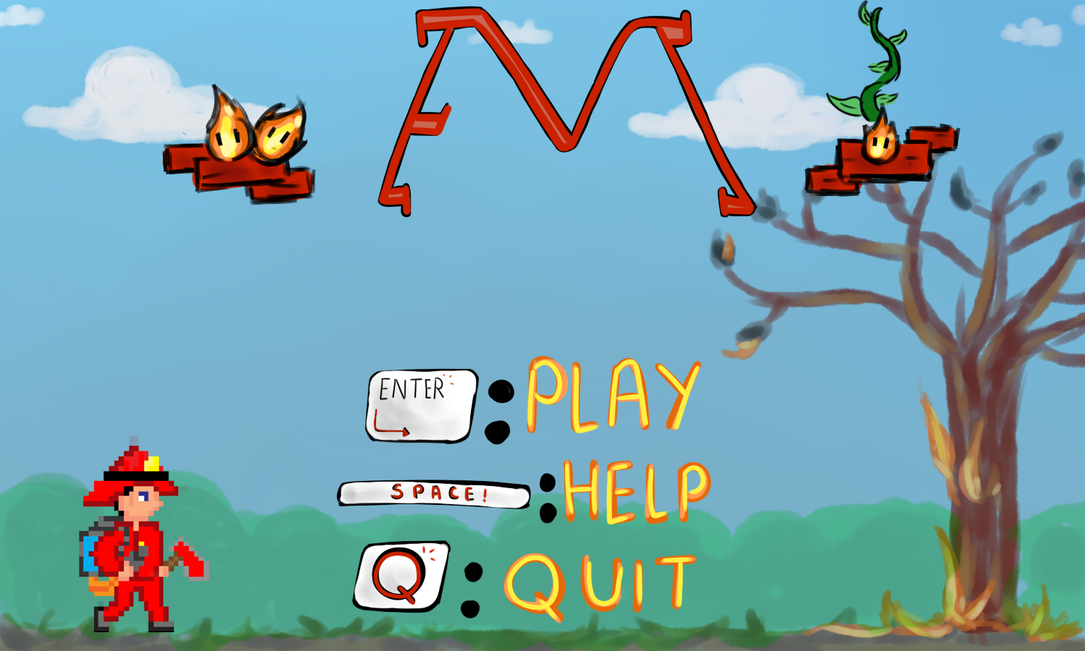

Slide 4
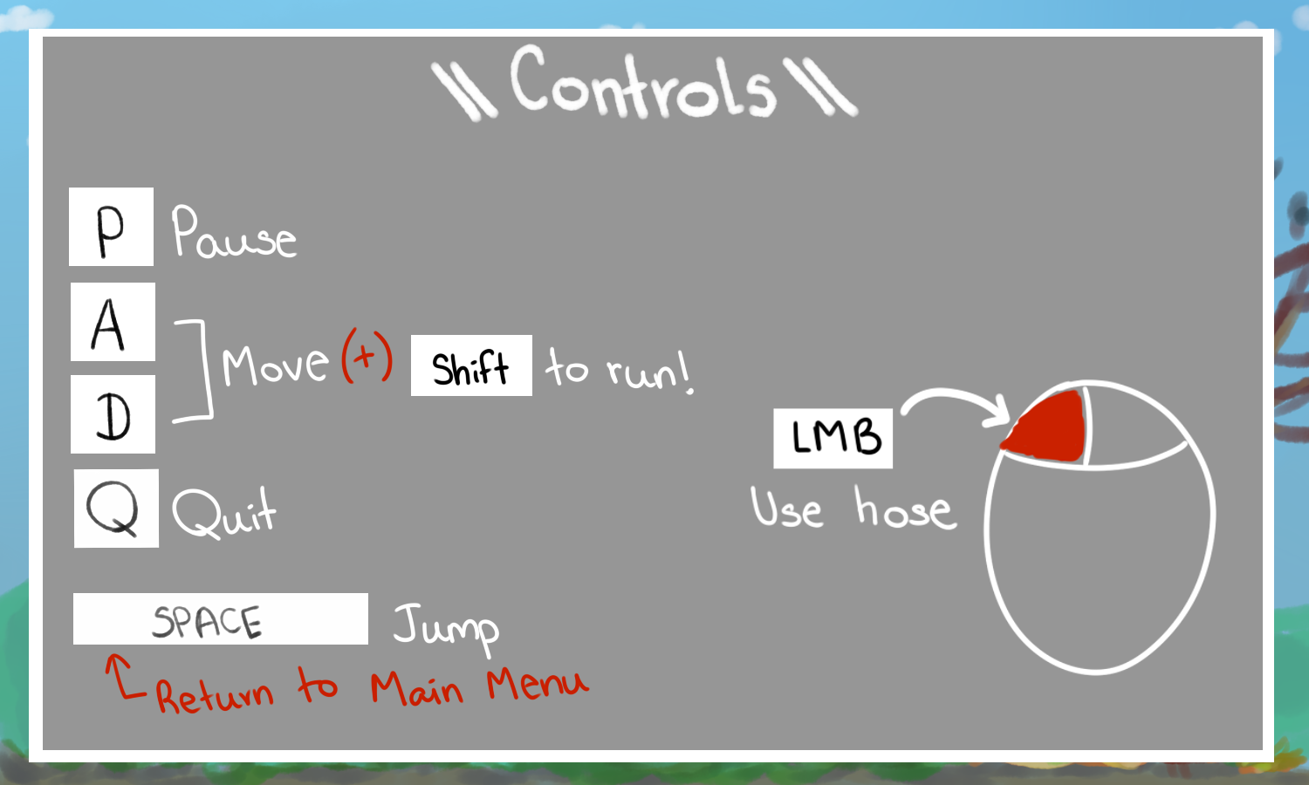

Slide 5
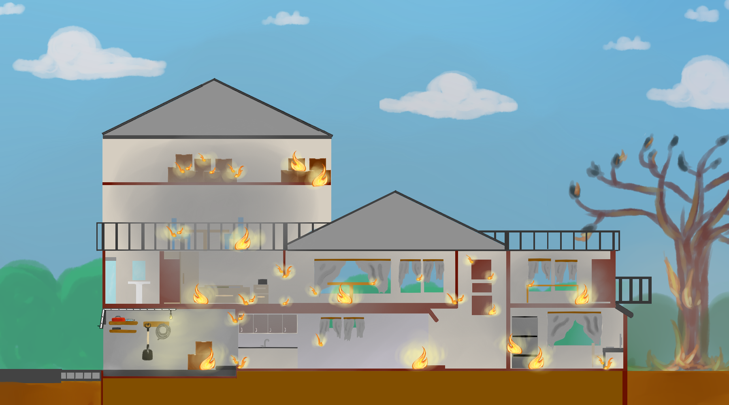

Slide 6
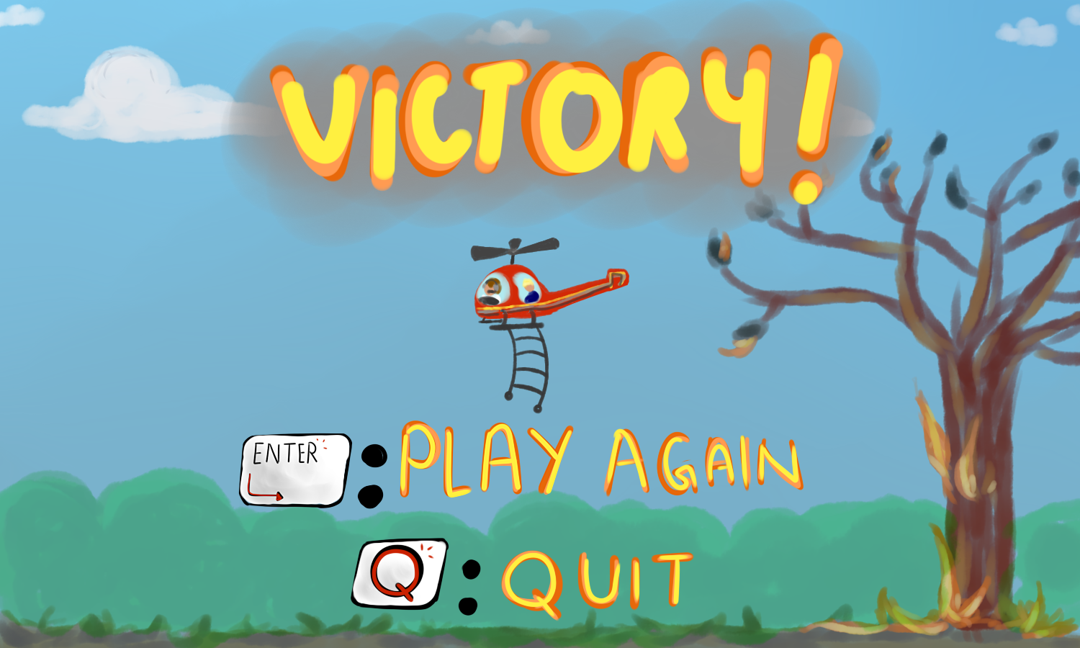

Slide 7
What Went Right?
Stayed true to original idea
Art assets
Code Architecture
Level Design
Interaction between player and fire
Hard Coding the level
External Tool
Teamwork

Slide 8
What Went Wrong?
The collision between player & fire & water
Jumping / gravity / collision of player and ground
Asset animations
Camera movement
Timing with due dates
Scheduling conflicts
Group drop-out

Slide 9
What Was Axed
The Axe
Multiple Levels
360 Shooting
Player Animations
Extra Modes
Controller Support

Slide 10
What Did We Learn?
The essential mechanics take a lot longer to code than expected
Have to adapt to changing groups
How to work in a team environment, especially on how games are made
Communicating with team mates

Slide 11
What Would We Do Differently?
Scheduling stricter due dates
Start on everything sooner
Keep track of time spent working

